Slide 1
Exercises 01
Computer Graphics 2021
Erica Stella (erica.stella@polimi.it)

Slide 2
DISCLAIMER
These exercises are purely for learning purposes, they will NOT be asked during the exams
Don’t worry if you don’t finish them today, solutions will be posted, but please review them before the next lesson because we will build upon them
If you have questions, you can use the forum or ask me next time ☺
Before plunging into the code, please open the file for a quick look ☺

Slide 3

Ex 1
Change the colour of the triangle to (0.6, 0.7, 0.2)
Final look:

Slide 4
Solution Ex 1
Vertex Shader
Fragment Shader
#version 300 es
in vec4 a_position;
void main() {
gl_Position = a_position;
}
#version 300 es
precision mediump float;
out vec4 outColor;
void main() {
//Change the final colour here
outColor = vec4(0.6, 0.7, 0.2, 1);
}

Slide 5

Ex 2
Use the uniform diff_colour to colour the triangle
Final look:

Slide 6
Solution Ex 2
Vertex Shader
Fragment Shader
#version 300 es
in vec4 a_position;
void main() {
gl_Position = a_position;
}
#version 300 es
precision mediump float;
//uniform passed here
uniform vec3 diff_colour;
out vec4 outColor;
void main() {
//Change the final colour here
outColor = vec4(diff_colour, 1);
}

Slide 7
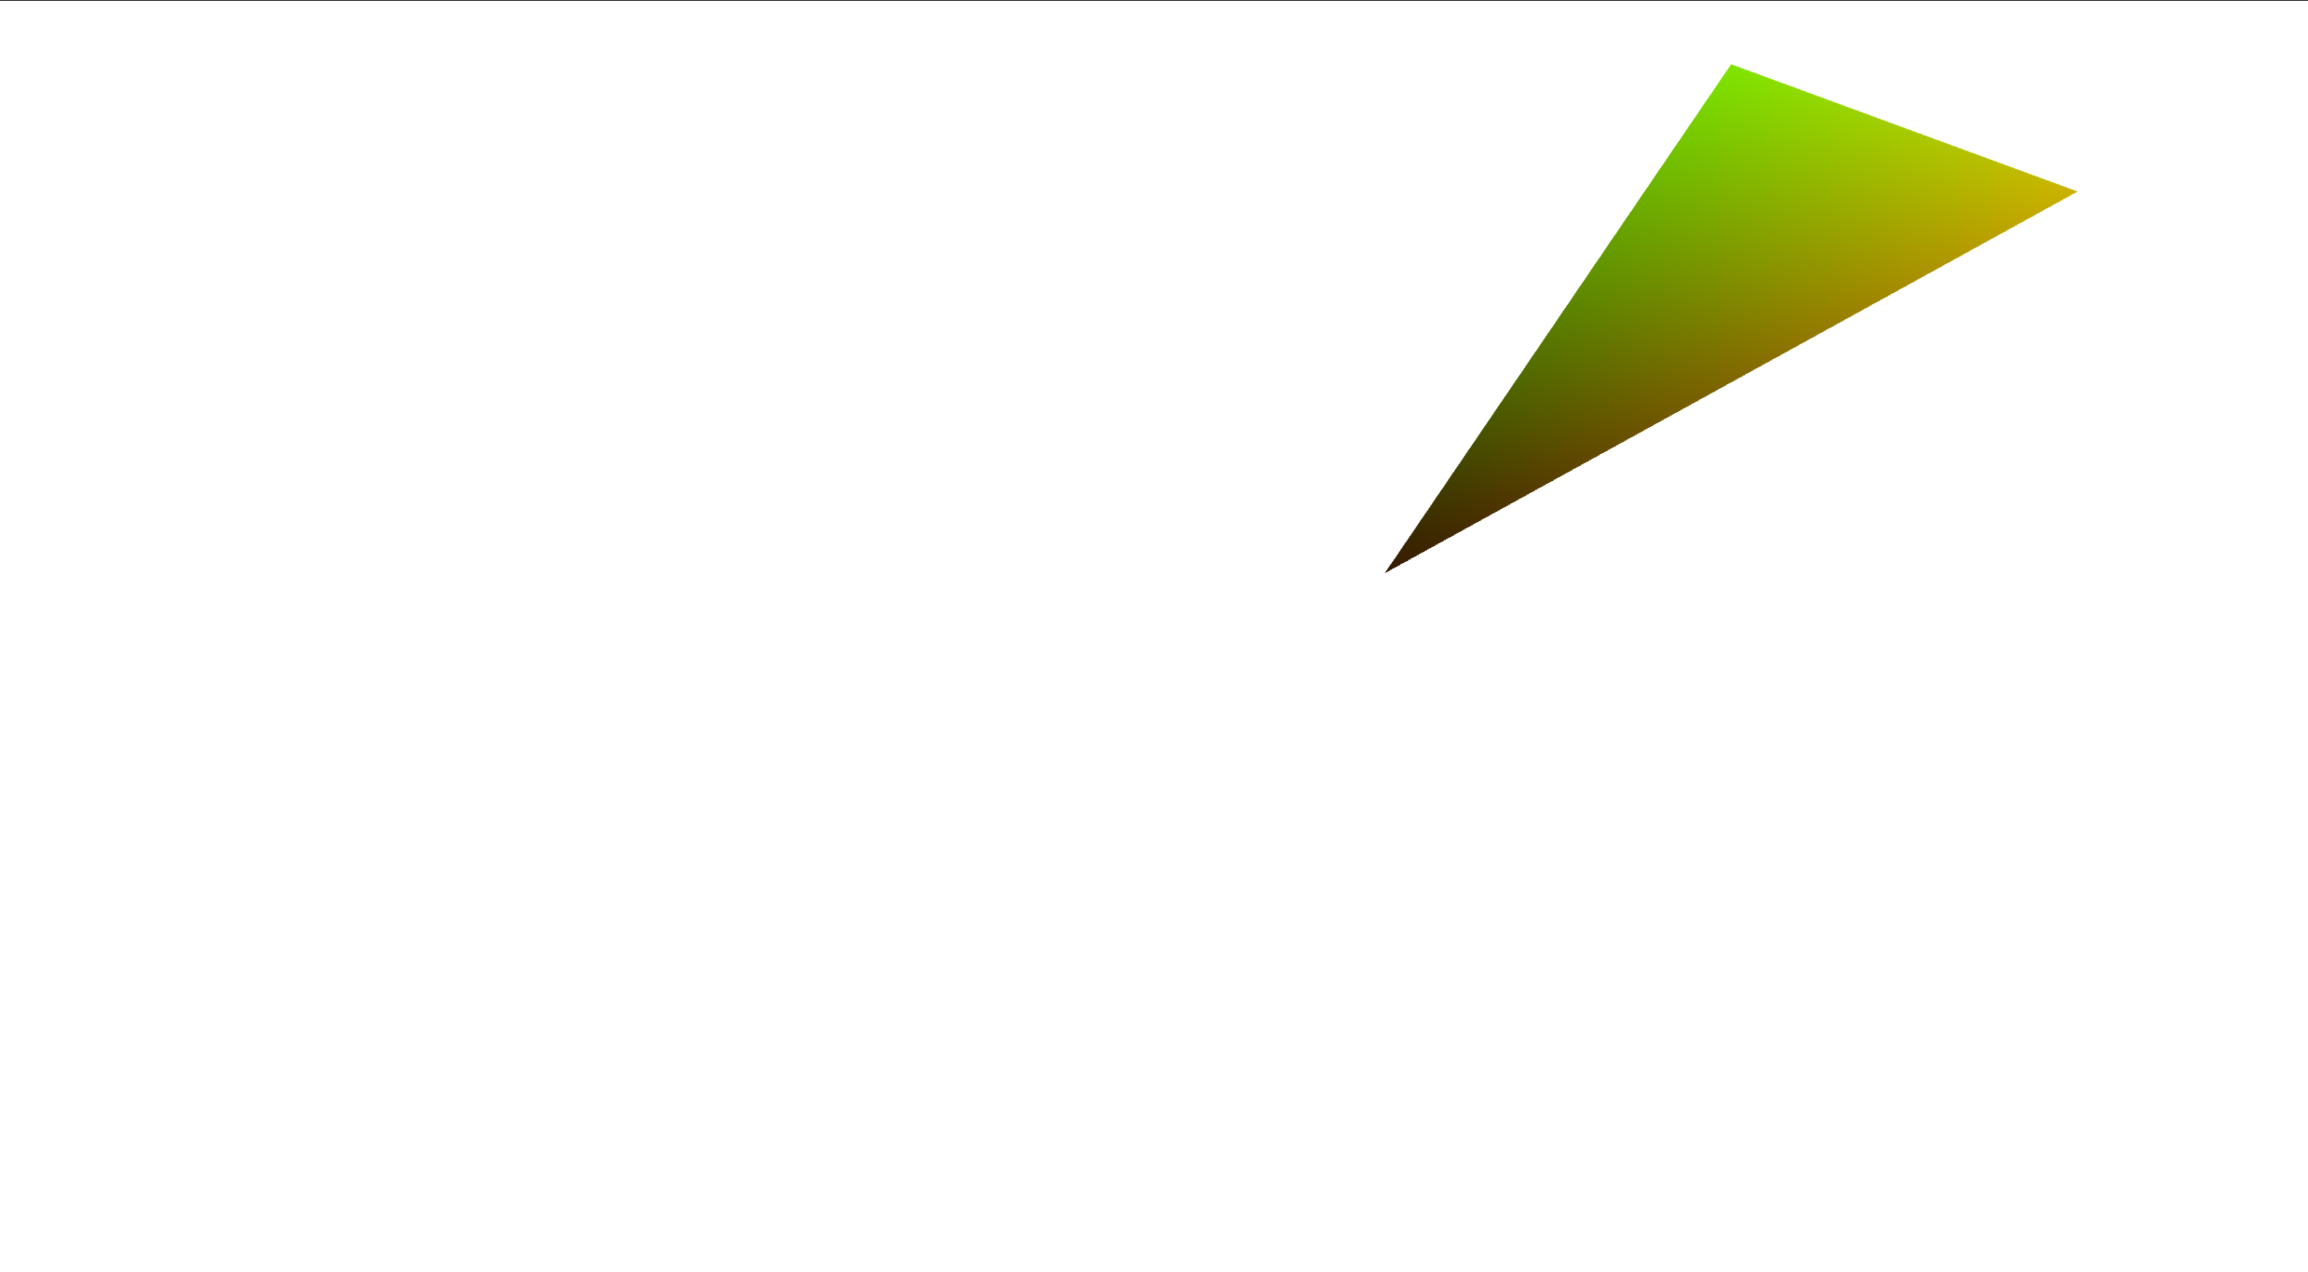
Ex 3
Set the colour of the triangle so that the red component is equal to the x coordinate of the point (in clip coords), the green is equal to the y coordinate of the point (in clip coords), and the blue is equal to 0.0
Hint: a_position in VS is already in clip coords (in this case)
Final look:

Slide 8
Solution Ex 3
Vertex Shader
Fragment Shader
#version 300 es
in vec4 a_position;
//Pass the clip coords to the FS as out
//Use a vec2 because we only need x and y
out vec2 fs_pos;
void main() {
//Extract just x and y from a vec4
fs_pos = a_position.xy;
gl_Position = a_position;
}
#version 300 es
precision mediump float;
//Retrieve the vec2 passed from the VS
//Remember the values have been //interpolated along the primitive
in vec2 fs_pos;
out vec4 outColor;
void main() {
//Change the final colour here
//R = x, G = y, B = 0.0
outColor = vec4(fs_pos.x, fs_pos.y, 0.0, 1.0);
}

Slide 9

Ex 4
Make the red component of the colour of the triangle change over time as the sine function (G=0, B=0)
Hints:
The uniform radians_over_time already changes as time passes
Sine function: https://www.khronos.org/registry/OpenGL-Refpages/es3.0/html/sin.xhtml
Remember sin(x) ∈ [-1; 1], colours ∈ [0;1]
Final look:

Slide 10
Solution Ex 4
Vertex Shader
Fragment Shader
#version 300 es
in vec4 a_position;
void main() {
gl_Position = a_position;
}
#version 300 es
precision mediump float;
//This value already changes as time passes
uniform float radians_over_time;
out vec4 outColor;
void main() {
//We need to move the value of the sine from [-1;1] to [0;1] as this is the range for colours (less than 0 is black, more than 1 is white)
float value = sin(radians_over_time) * 0.5 + 0.5;
outColor = vec4(value, 0.0, 0.0, 1.0);
}

Slide 11

Ex 5
Use the colour passed in the attribute a_colour to colour the triangle
Final look:

Slide 12
Solution Ex 5
Vertex Shader
Fragment Shader
#version 300 es
in vec4 a_position;
//This attribute contains one colour for each vertex
in vec3 a_colour;
//This is passed to the FS and interpolated
out vec3 fs_colour;
void main() {
//Simply pass the input value to the FS
fs_colour = a_colour;
gl_Position = a_position;
}
#version 300 es
precision mediump float;
//Receive the interpolated input
in vec3 fs_colour;
out vec4 outColor;
void main() {
//Simply set it as colour
outColor = vec4(fs_colour, 0.0, 1.0);
}

Slide 13
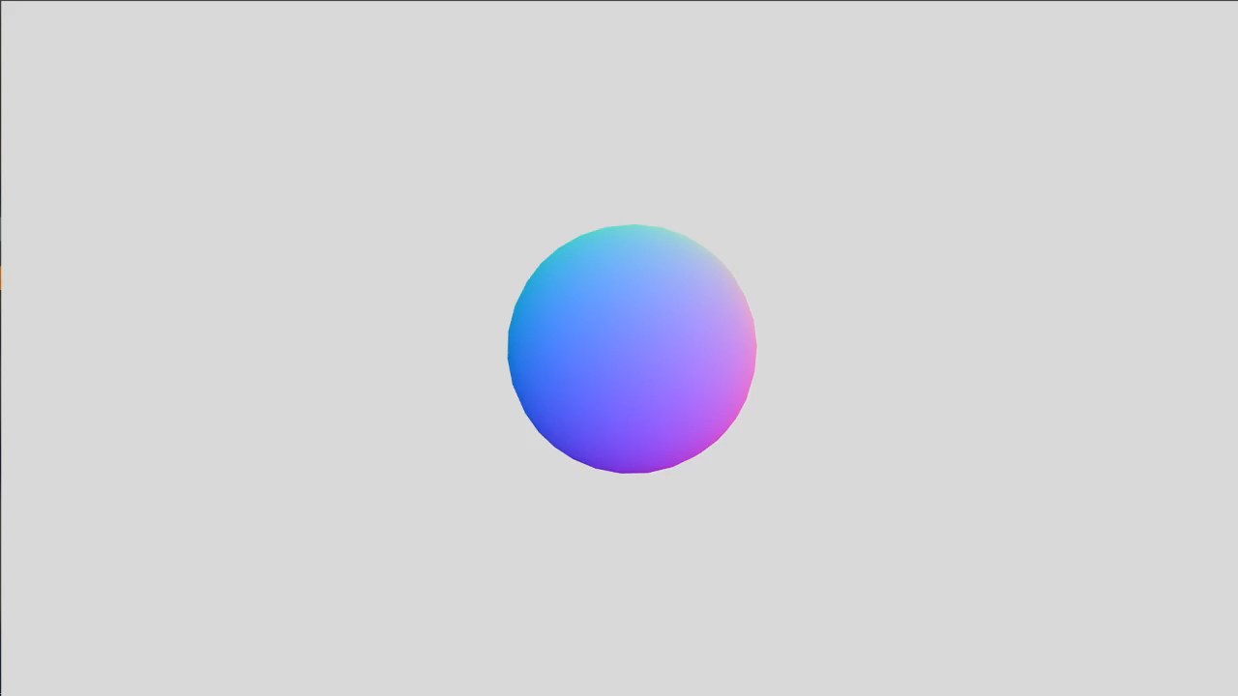
Ex 6
Use the normal passed in the attribute a_normal to colour the triangle e.g. r= n_{x}, g=n_{y}, b=n_{z}
Hints:
Normals must be normalised after being passed to the FS
Normalize function: https://www.khronos.org/registry/OpenGL-Refpages/es3.0/html/normalize.xhtml
Normals are ∈ [-1;1]…
Final look:
Move the sphere with the arrows ☺

Slide 14
Solution Ex 6
Vertex Shader
Fragment Shader
#version 300 es
in vec4 a_position;
//Receive the normal per-vertex as input
in vec3 a_normal;
//Pass it to the FS out vec3 fs_norm;
void main() {
fs_norm = a_normal;
gl_Position = a_position;
}
#version 300 es
precision mediump float;
//Receive the interpolated normal
in vec3 fs_norm;
void main() {
//The normal is normalized and brought
//back to the [0;1] range
vec3 norm = normalize(fs_norm)*0.5+0.5;
outColor = vec4(norm, 1.0);
}

Slide 15
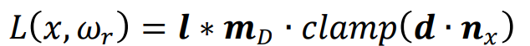
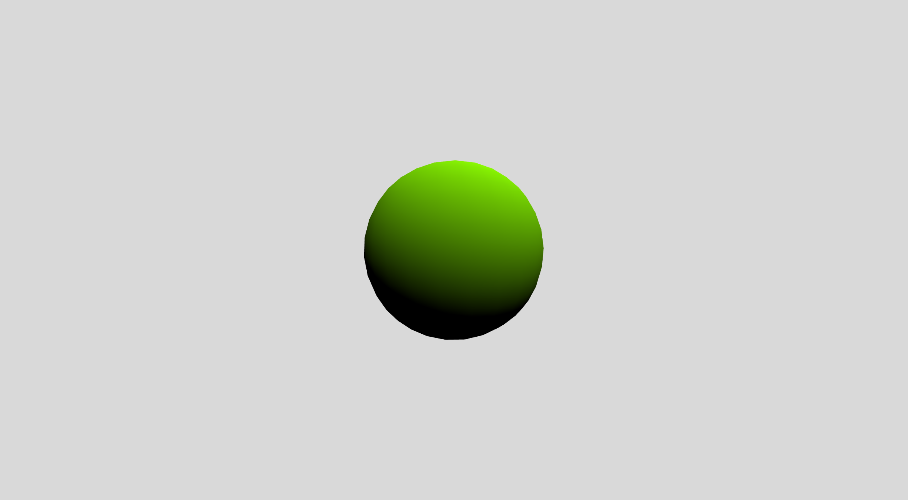
Ex 7
Implement Lambert diffuse with one directional light
Hints:
All the necessary attributes and uniforms are already available
The Lambert brdf is computed as:
Dot function: https://www.khronos.org/registry/OpenGL-Refpages/es3.0/html/dot.xhtml
Clamp function: https://www.khronos.org/registry/OpenGL-Refpages/es3.0/html/clamp.xhtml
Final look:
Move the sphere with the arrows ☺

Slide 16
Solution Ex 7 - VS
Vertex Shader
#version 300 es
in vec4 a_position;
in vec3 a_normal; out vec3 fs_norm;
uniform mat4 matrix;
//We need to transform the normals from obj space to world space
//We will see in a future lesson how to do it and why
uniform mat4 nMatrix;
void main() {
fs_norm = mat3(nMatrix) * a_normal;
gl_Position = matrix * vec4(a_position,1.0);
}

Slide 17
Solution Ex 7 - FS
Fragment Shader
#version 300 es
precision mediump float;
in vec3 fs_norm;
uniform vec3 mDiffColor; //material diffuse color
uniform vec3 lightDirection; // directional light direction vec
uniform vec3 lightColor; //directional light color
out vec4 outColor;
void main() {
//Need to normalize the interpolated normal and light direction
vec3 norm = normalize(fs_norm);
vec3 nLightDirection = normalize(lightDirection);
//Here you should use either lightDirection or -lightDirection depending on
//whether the direction has been inverted in webgl
//In this case it has been inverted in webgl
vec3 lambertColor = mDiffColor * lightColor * clamp(dot(nLightDirection,norm), 0.0, 1.0);
outColor = vec4(lambertColor, 1.0);
}

